Slide 1

Blockchain Technology

Slide 2


let's first understand intermediaries and their role in-detail before we delve into Blockchain

Slide 3
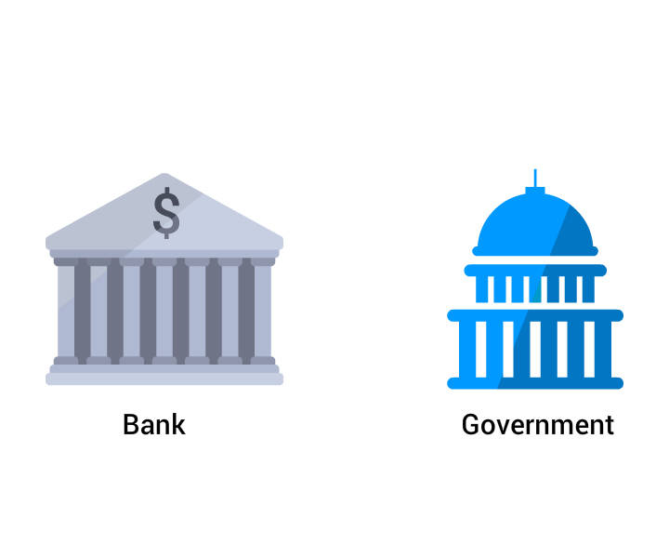
Banks and Governments act as intermediaries creating trust and certainty by facilitating the transaction of goods and services.
Electronic Payment
Real Estate

Slide 4
Life Without Intermediaries
Let's imagine direct business-to-business or peer-to-peer transactions without the involvement of any
Banks
Government
Intermediaries of any kind.
And what if a Technology could provide you the same experience without giving room for any delays due to a process or regulation without compromising on the security aspect.

Slide 5

But how?

Slide 6
Welcome to the World of Blockchain!

Slide 7
WHAT IS THE BLOCKCHAIN
Blockchain technology creates decentralized digital public record of transation
Which are
Secure
Anonymous
Tamper-proof
Unchangeable

Slide 8

"Blockchain raised a business value, which will cross $3.1 trillion by 2030", according to Gartner's Blockchain trend insight report 2017.

Slide 9
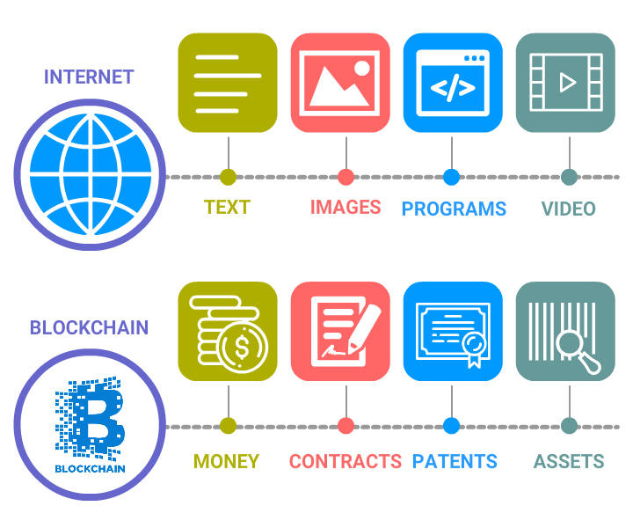
Evolution of Blockchain

Slide 10
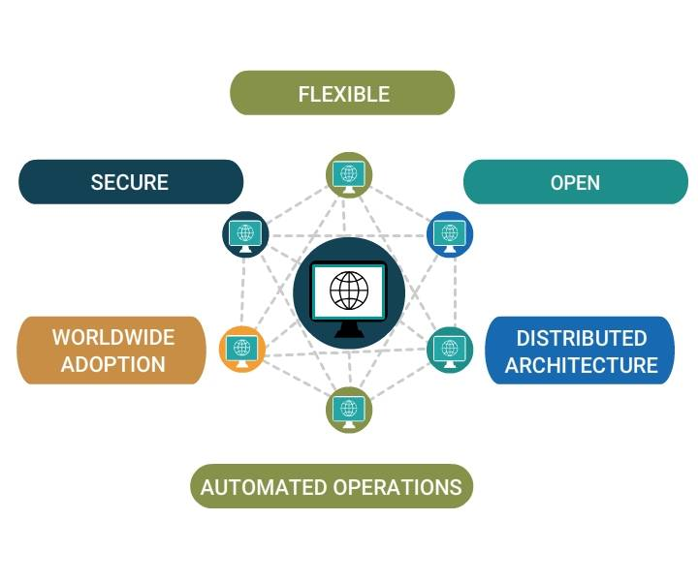
How can Blockchain Help?
Decentralized Power - Blockchain uses Peer-to-Peer node networking system.
Public Ledgers - Every node has its own public ledger with details of all transactions.
Immutable hacking - Since same data is available in the distributed network, hacking is impossible.
Cryptography - Uses a complex mathematical algorithm to maintain the blocks in Blockchain.

Slide 11
“Technologists believe it is the Digital immutability feature that makes blockchain desirable across many industries. Digital immutability can be described as once a record is committed on a blockchain, it is practically impossible to change the record”

Slide 12
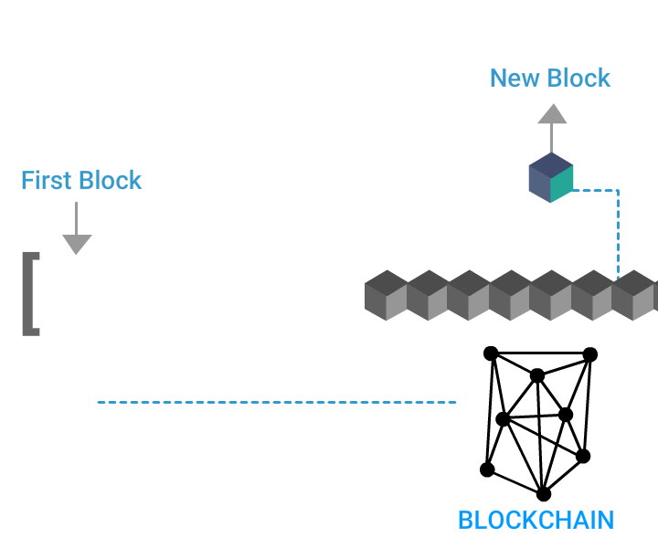
Building Blocks of BlockChain

Slide 13
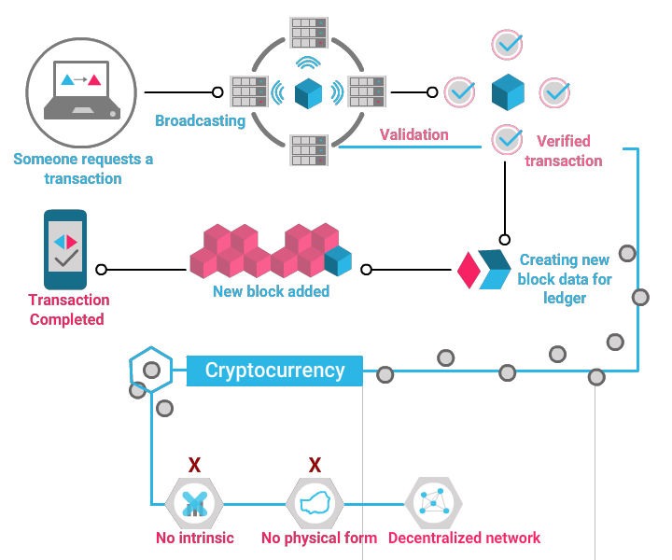
How Blockchain Works?

Slide 14
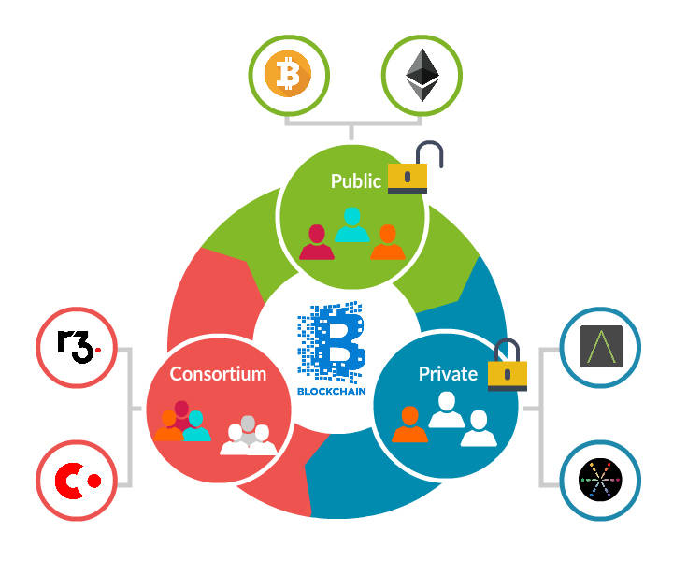
Types of Blockchain
Public Blockchain
Private Blockchain
Consortium/Federated Blockchain

Slide 15
“Blockchain is expected to disrupt the Banking and financial industry soon. Experts claim banks could save $8-12 billion annually by leveraging blockchain technology.”

Slide 16
Need for Different Types
The different types of BlockChain evolved to address several needs such as:
Cost-effectiveness and quick turnaround.
Reducing redundant work.
Dependency on huge servers.
Leveraging smart contracts, thereby reducing the number of trusted parties.
Generating distributed consensus among interested parties is faster irrespective of geographical segregation.
Including additional options for rights and access management.

Slide 17
Unprecedented Prowess: Blockchain, the Future
Blockchain has the capability to revolutionize the global economy.
Blockchain technology enables super-fast, super-secure, anonymous, and wholly transparent validation of transactions.

Slide 18
Boon to Industries
The blockchain is a globally distributed ledger where not just information but anything of value like money, music, medical, ND scientific discoveries can be secured.
The impact of blockchain goes way beyond the financial sectors.
Healthcare
Retail
Banking
Insurance
Telecom and so on

Slide 19

THANK YOU

